Slide 1
Risk Management
Leverage

Slide 2
WHAT IS LEVERAGE
Regular Trading
100% account cash
Leverage Trading
100% account margin
Plus loan from exchanges

Slide 3

LEVERAGE TRADING Multiplier
Amplify position value
$PV =\$FundsIn × \#Leverage$
Amplify profit and loss
$PNL=\%Moving × \#Leverage$

Slide 4
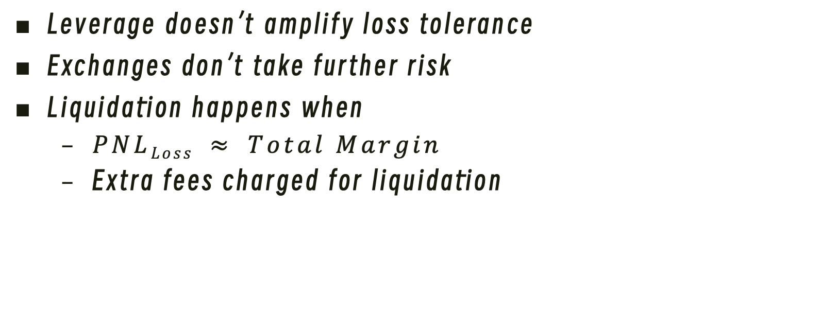
LEVERAGE TRADING Liquidation
Leverage doesn’t amplify loss tolerance
Exchanges don’t take further risk
Liquidation happens when
$PNLLoss ≈ Total Margin$
Extra fees charged for liquidation

Slide 5
LEVERAGE TRADING Fees
Interests and Funding Fees
Periodically (per hour or per 8-hour)
Trading Fees
Each transection (enter or exit)

